Slide 1
Project Output
Data analysis and visualization using R, GGPLOT2
By: Nitin Mudgal

Slide 2
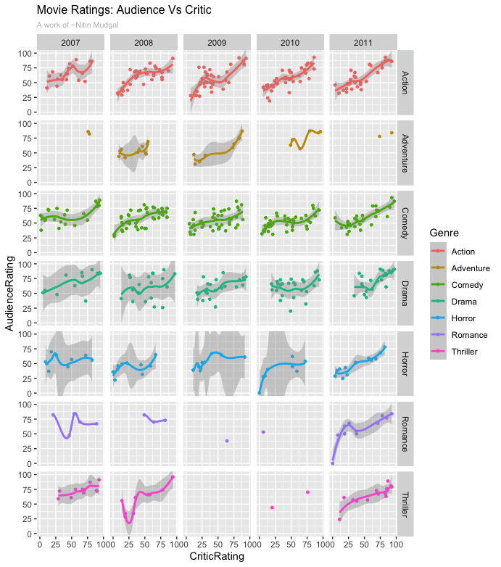
Plot 1: Genre wise trend for movie ratings, rated by critic and audience, yearly representation.

Slide 3
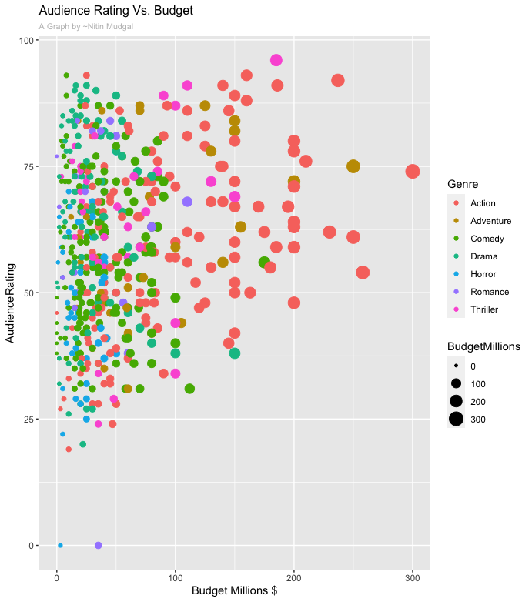
PLOT2: Scatter plot, Ratings by Audience vs budget, further divided by genre

Slide 4
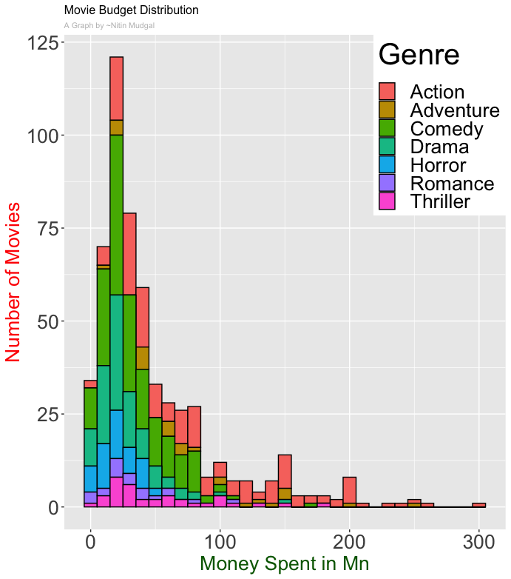
Genre wise movie budget distribution

Slide 5
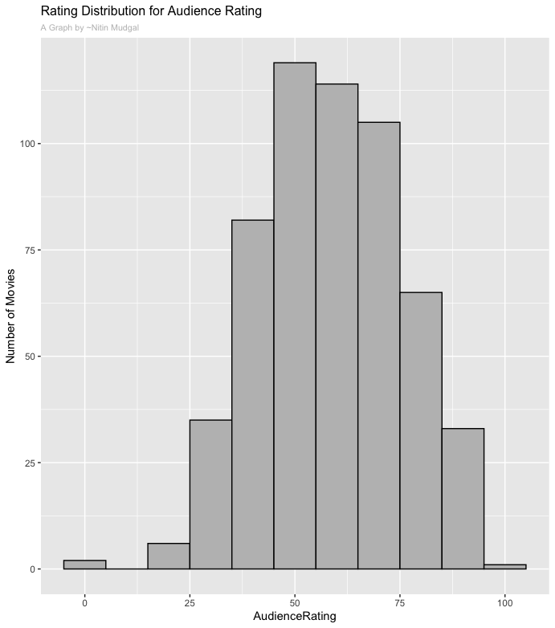
Overall audience rating distribution trend, representing normal distribution, using histogram

Slide 6
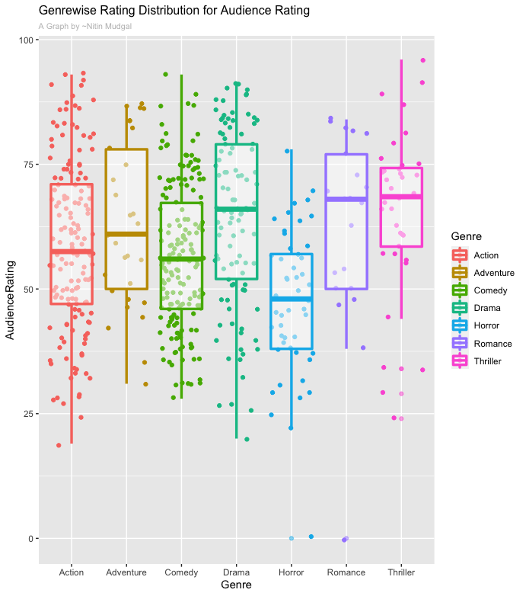
Genre-wise average rating distribution for audience rating, using box plot

